Slide 1
Finding the Subnet, Broadcast and Useable Host Ranges
Lecture 5
Finding the Subnet, Broadcast and Useable Host Ranges

Slide 2
Introduction
Subnetting creates smaller networks out of large networks by borrowing host bits to create the subnet field, which is made up of the borrowed bits.
Subnetting increases network efficiency and security by decreasing the size of broadcast domains.
Routers are used to create subnets because OSI Layer 3 addressing (IP addresses) is used for subnetting
The formula (2^{n}) or 2^{n}-2=x will calculate the number of subnets created when n equals the number of host bits borrowed to create the subnet field.
The formula 2^{m}-2=x will calculate the number of hosts per subnet created when m equals the number of remaining host bits after creating the subnet field .

Slide 3
Cont.
Two host bits must remain after borrowing host bits to create subnets, so the maximum number of host bits that can be borrowed in a Class A network is 22, in a Class B network is 14, and in a Class C network is 6.
When expanding the subnet address ranges, the first and last networks created are not usable; the host portion of the subnet address of the first subnet (normally listed as the 0 subnet) is all binary zeros and not usable; the host portion of the broadcast address on the last subnet is all binary ones, which makes that network unusable.
When expanding the subnet address ranges, the first address will be the subnet address and the last address will be the broadcast address for that subnet; the useable host addresses will be the second address through the next to last address.

Slide 4
Cont.
Incrementing subnets always starts in the octet of the last borrowed bit; on a Class C network it is always in the fourth octet, on a Class B network incrementing can be in the third or fourth octet depending on which octet the last borrowed bit was in; on a Class A network incrementing can be in the second, third, or fourth octet depending on which octet the last borrowed bit was in.

Slide 5
Class Work
You are assigned an IP address of 172.30.0.0 and you need 1000 hosts on your network, what is your subnet mask?
Answer
255.255.254.0

Slide 6
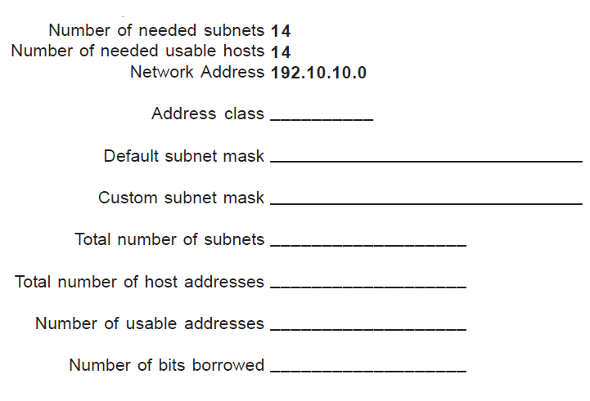
Class Work 1

Slide 7
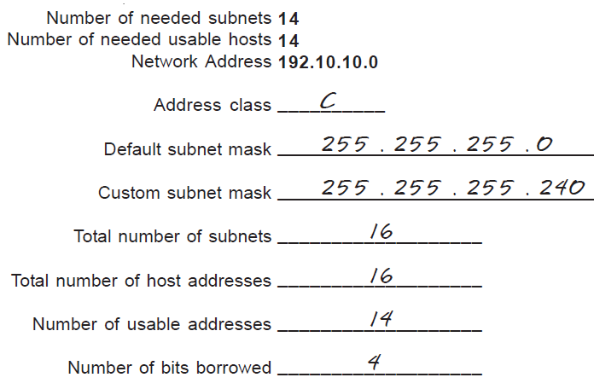
Solution

Slide 8
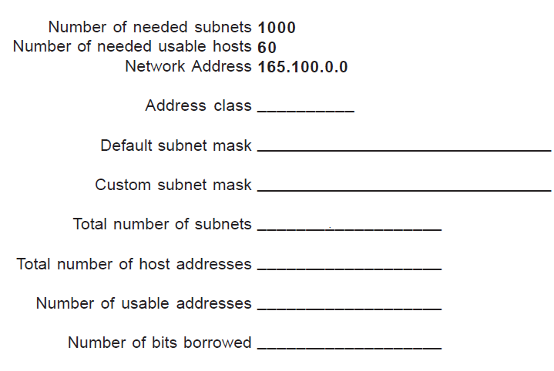
Class Work 2

Slide 9
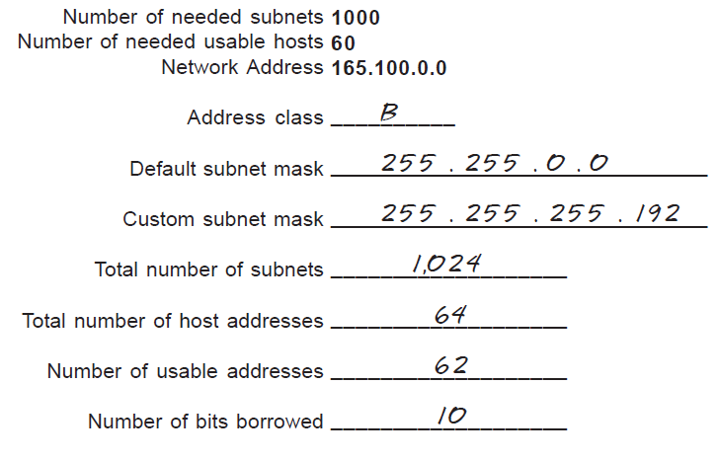
Solution 2

Slide 10
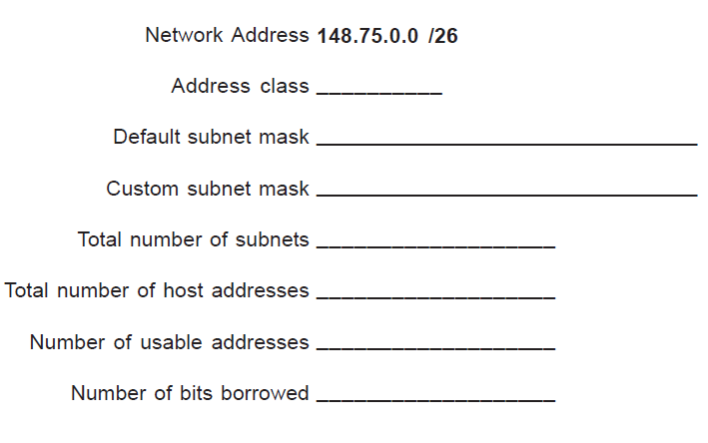
Class Work 3

Slide 11
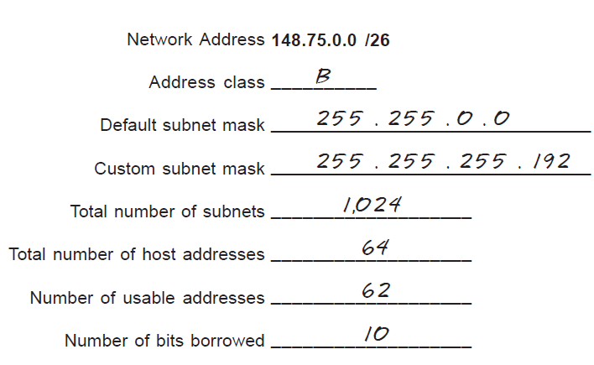
Solution 3

Slide 12
Class Work 4
Write the subnet, broadcast address and valid host range for the following: 172.16.10.5 255.255.255.128.
Answer 4
Subnet is 172.16.10.0, broadcast is 172.16.10.127 and valid host range is 172.16.10.1 to 126.

Slide 13
Class Work 5
Write the subnet, broadcast address and valid host range for the following: 172.16.10.33 255.255.255.224
Answer 5
Subnet is 172.16.10.32, broadcast is 172.16.10.63 and valid host range is 172.16.10.33 to 10.62.

Slide 14
Class Work 6
Write the subnet, broadcast address and valid host range for the following: 172.16.10.65 255.255.255.192
Answer 6
Subnet is 172.16.10.64, broadcast is 172.16.10.127 and valid host range is 172.16.10.65 to 172.16.10.126.

Slide 15
Class Work 7
Write the subnet, broadcast address and valid host range for the following: 172.16.10.17 255.255.255.252.
Answer 7
Network is 172.16.10.16, broadcast is 172.16.10.19 and valid host range is 172.16.10.17 to 18.

Slide 16
Class Work 8
Write the subnet, broadcast address and valid host range for the following: 172.16.10.33 255.255.255.240
Answer 8
Network is 172.16.10.32, broadcast is 172.16.10.47 and valid host range is 172.16.10.33 to 46.

Slide 17
Class Work 9
Write the subnet, broadcast address and valid host range for the following: 192.168.100.25 255.255.255.252.
Answer 9
Subnet is 192.168.100.24, broadcast is 192.168.100.27 and valid host range is 192.168.100.25 to 26.

Slide 18
Class Work 10
Write the subnet, broadcast address and valid host range for the following: 192.168.100.17, with 4 bits of subnetting.
Answer 10
Subnet is 192.168.100.16, broadcast is 192.168.100.31 and valid host range is 192.168.100.17 to 30. 256-240=16.

Slide 19
Class Work 11
Write the subnet, broadcast address and valid host range for the following: 192.168.100.66, with 3 bits of subnetting.
Answer 11
Subnet is 192.168.100.64, broadcast is 192.168.100.71 and valid host range is 192.168.100.65 to 70.

Slide 20
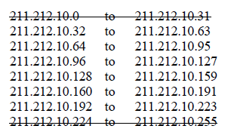
Class Work 12
A company is granted the site address 211.212.10.0. The company needs five subnets. Design the subnet.
Answer 12
11010011.11010100.00001010.00000000
Class C address (Range 0 to 127)
Needs 8 subnet
Important Note: Use the first and last address. Write down the host address. You must show the host address.

Slide 21
Class Work 13
A company is granted the site address 131.107.0.0.The company needs 1000 subnets. Design the subnet. Write down the range of first 9 subnets.
Answer 13
10000011. 01101011.00000000.00000000
Class B: 127 to 198
Number of subnet need to be designed 2¹⁰ ⁼1024
You can borrow 10 0’s from host part.
Then the subnet mask is
11111111.11111111.11111111.11000000
Which is 255.255.255.192

Slide 22
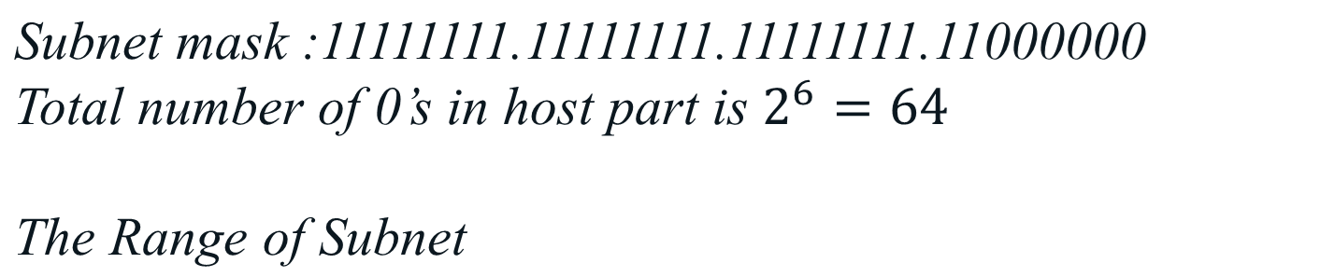
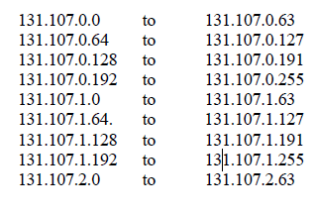
Class Work 13

Slide 23
Class Work 14
A company is granted the site address 172.190.0.0.The company needs 10 subnets. Design the subnet. Write down the range of first 9 subnets.
Answer 14
Note: Use the first and last subnet

